Slide 1
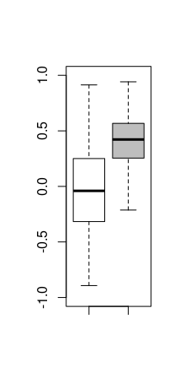
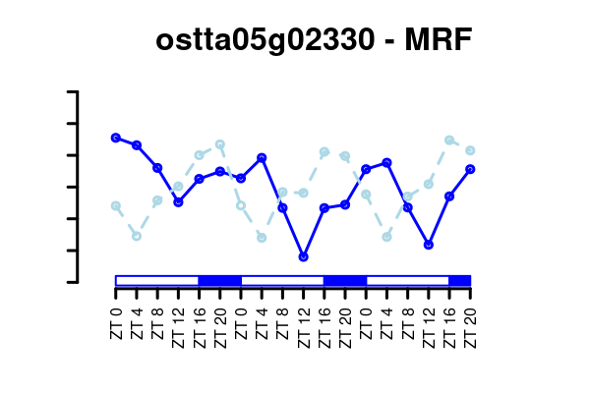
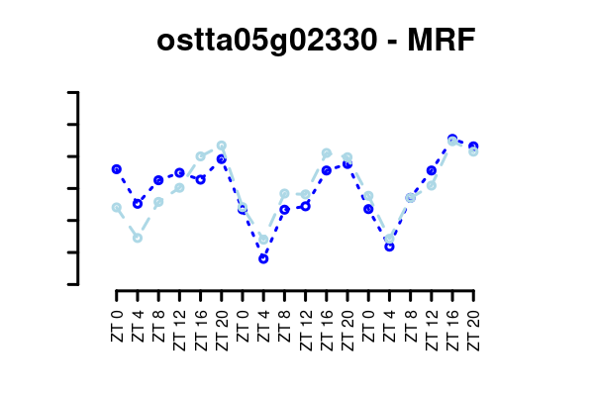
(A)
(B)
Scaled Gene Expression
Protein Abundance
Gene/Protein Profiles Correlation
(C)
Scaled Gene Expression
Protein Abundance
Shifted Phase Aligned Profiles
Original Out of
Phase Profiles

